Slide 1






Computational Network Design from Functional Specifications
Chi-Han Peng, Yong-Liang Yang, Fan Bao, Daniel Fink,
Dong-Ming Yan, Peter Wonka, Niloy J. Mitra
Notes:
Good morning everyone. Let me introduce our work about network design from functional specifications.

Slide 2

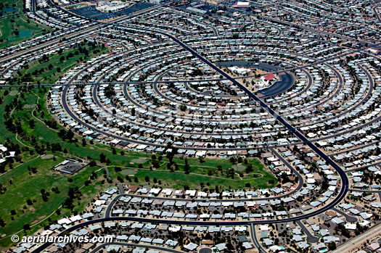
Functions of street networks
Traffic demand, land use, topology constraints, etc.
London
Phoenix
Notes:
The goal of this paper is to develop a method that can automatically generate street networks purely from high-level specifications of their functions. Examples of such functional specifications include traffic demand, land use, and topology constraints.

Slide 3



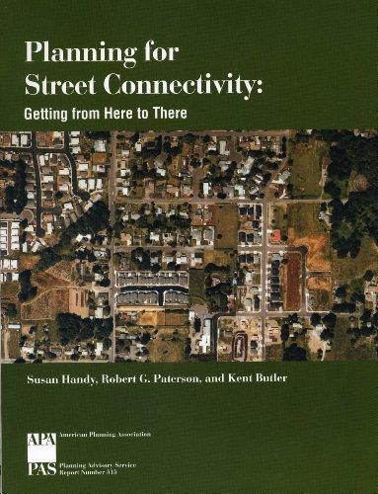


Understanding current design practices
Based on interviewing professionals and consulting literature.
Notes:
To understand the current design practices, we do interviewed professionals in the academia and industry and consulted literature in the field.

Slide 4
Current practice: iterative network design
. . .
Design
?
Functional
Testing
. . .
Notes:
We find that the current design practice is to iterate between two stages: design and functional testing.
[Click] In the design stage, urban planners is given a problem domain usually within a larger context, and maybe a set of high-level function goals, [Click] then, the planer propose initial designs based on their knowledge and prior experience.
[Click] The designs are then tested by, say, traffic engineers, to provide testing results to the planners. The planners then refine the designs accordingly.
[Click] The process iterates until the result is satisfactory, or time is running out.
We see that a main problem is that the functional testing does not provide direct feedback on how to improve the designs. So, the planners have to rely on their past knowledge to make the changes; to make educated guesses. This often leads to a long and tedious process.

Slide 5
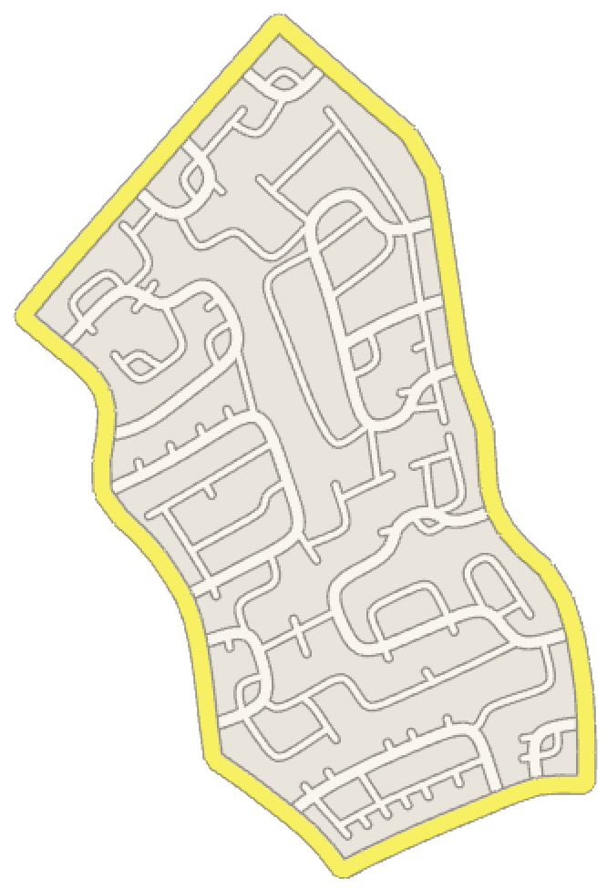
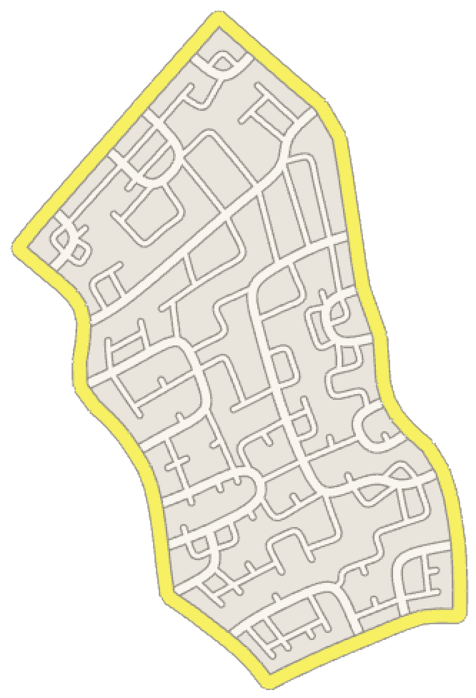

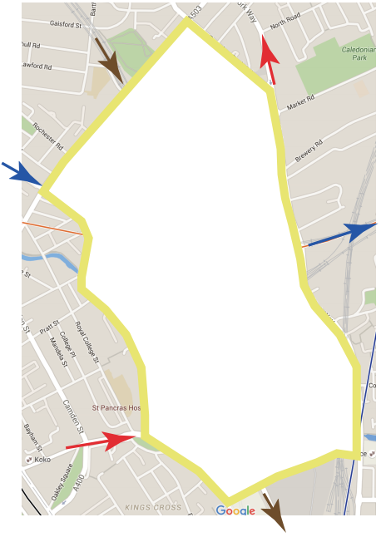
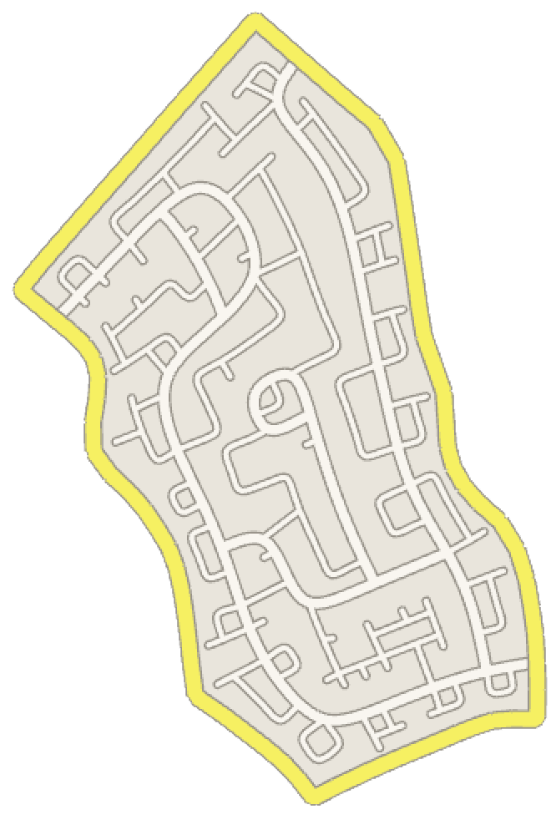
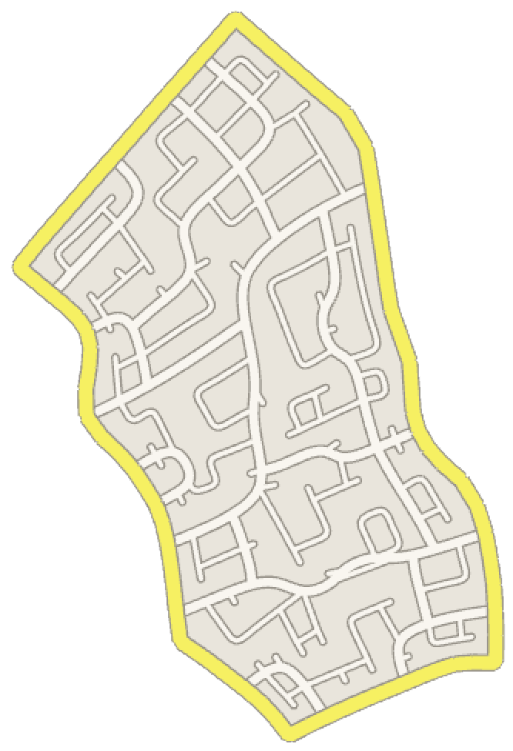
Our solution
Complete street layouts
Functional
specifications
IP-based
method
?
…
Notes:
Instead, our solution is to propose a method that can automatically generate street network designs given just a problem domain and a set of functional specifications as inputs, therefore have the potential to great simplify the design process.

Slide 6
Functional specifications
Land use
Density
Notes:
Based on our research, we identified a set of recurring functional specifications.
[Click] A good proxy to handle land use specification is via controlling the network’s density. It encodes the average spacing between the network edges. Inversely, it can be specified as the coverage range of the network edges.

Slide 7
Functional specifications
Land use
Density
Traffic demand
Traffic types
Network lengths vs travel distances
Notes:
To handle traffic demand specifications, we propose two approaches.
The first is to specify the types of traffic that the network mainly to support. Form left to right, a network can support interior-to-boundary, interior-to-interior, and boundary-to-boundary traffic.
[Click] The second is the preference between two extremes of a network: minimizing network lengths versus minimizing travel distances. Here we show two examples such that every vertex needs to be covered and interior to boundary traffic needs to be supported. [Click] Minimizing length means that we want the network to sufficiently cover the domain while using as few edges as possible. This often leads to deep, tenuous networks such that some parts of the network would be far away from the boundary. [Click] On the contrary, minimizing travel distance means that we want the network to make travel to the boundary as quick as possible, even by using an excessive amount of edges.

Slide 8
Functional specifications
Topology constraints
Land use
Density
“Sink” locations
Traffic demand
Traffic types
Local features
Network lengths vs travel distances
User specifications
Notes:
To handle topology constraints, we propose two approaches.
First, the user can specify the “sink” locations of the network, that is, the destinations of the traffic to go to. From left to right, the sink locations can be all over the boundary, at only a subset of the boundary, or even inside the problem domain. As we will see shortly, this specification is likely to have a profound effect on the global topology of the networks. Note that this is also a connectivity constraint requiring that all parts of network have to be able to reach the sinks.
[Click] Another way to control the global topology is via controlling the local features. Examples include dead-ends, branches or T-junctions, and zig-zags.
[Click] Finally, users can directly control the generated networks by specifying certain locations as obstacles such that the generated network must avoid, ...and by enforcing certain routes to appear in the generated network, acting like short-cuts.

Slide 9
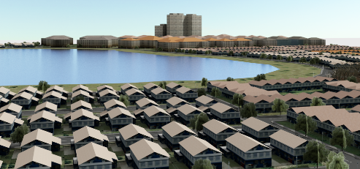
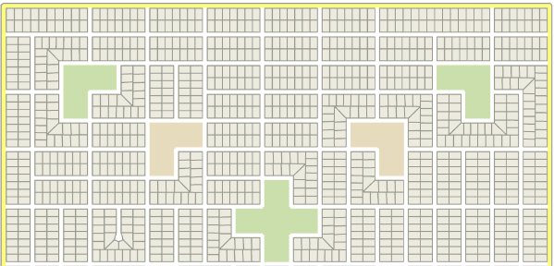
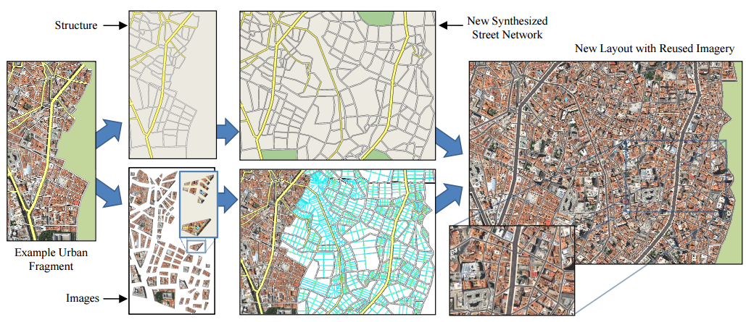
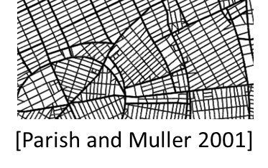
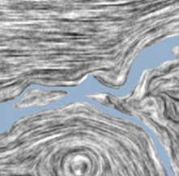
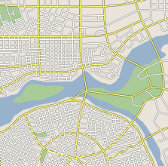
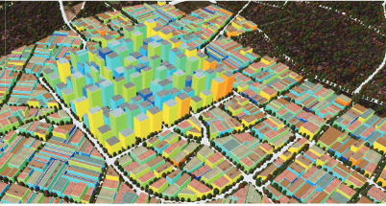
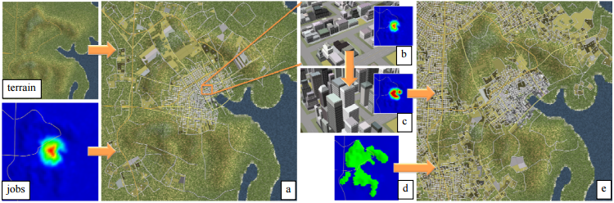
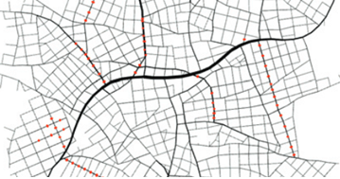
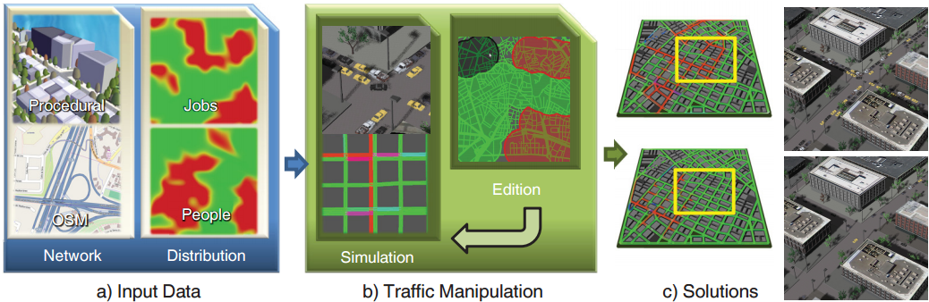
Related work - street modeling
[Yang et al. 2013]
[Peng et al. 2014]
Parcel modeling
[Parish and Muller 2001]
[Aliaga et al 2008]
Example-based
[Chen et al. 2008]
[Vanegas et al. 2012]
[Vanegas et al 2009]
[Weber et al. 2009]
Behavioral modeling
[Garcia-Dorado et al. 2014]
Procedural modeling
Modifying existing networks
Notes:
Let’s review related work about street modeling.
[Click] A popular way to generate street networks in computer graphics is via a procedural growth process.
[Click] Another good way is to synthesize street networks using real-world examples.
[Click] Some recent work began to model street networks from a “behavioral” perspective, for example, based on the distribution of population and jobs.
[Click] Alternatively, some recent urban modeling methods began by modeling the parcels and then have the street layouts emerge as a by-product.
[Click] Also, some work focus on modifying an existing network either from real-world or artificial sources, and they carry a functional perspective such as building sunlight exposures and traffic behaviors.

Slide 10
Related work - street modeling
[Yang et al. 2013]
[Peng et al. 2014]
Parcel modeling
[Parish and Muller 2001]
[Aliaga et al 2008]
Example-based
[Chen et al. 2008]
[Vanegas et al. 2012]
[Vanegas et al 2009]
[Weber et al. 2009]
Behavioral modeling
[Garcia-Dorado et al. 2014]
Procedural modeling
Modifying existing networks
Notes:
However, only some of them began to address the goal of computing networks to fulfill certain functional goals. But so far they are done only in an indirect and incremental manner. Instead, our work aims to generate street networks directly from functional specifications.

Slide 11

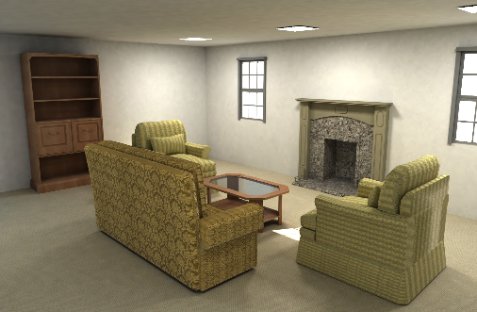
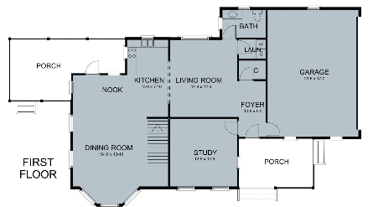
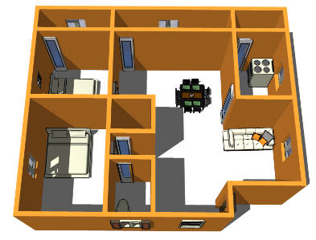
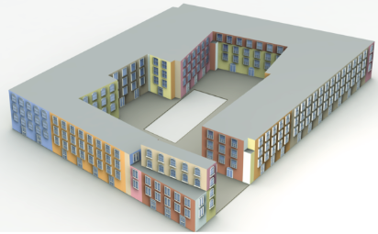
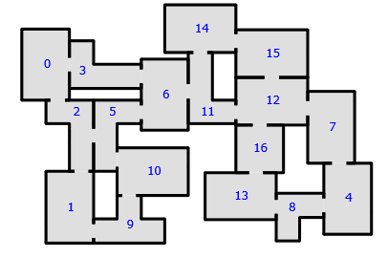
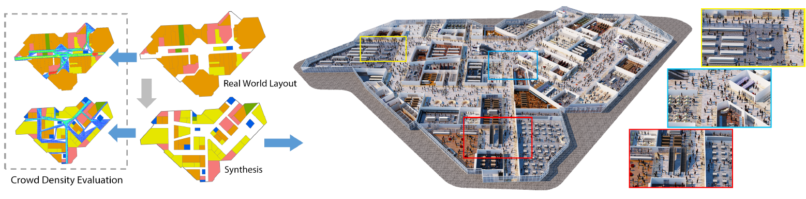
Related work - layout modeling
[Yu et al. 2011]
[Merrell et al. 2011]
[Merrell et al. 2010]
[Liu et al. 2013]
Furniture arrangements
Residential floorplans
[Bao et al. 2013]
[Ma et al. 2014]
[Feng et al. 2016]
Building layouts
Game levels
Mid-scale environments
Notes:
Our work is also related to other works about modeling layouts in man-made environments, such as furniture arrangements, residential floorplans, building layouts, and game levels. In particular, Feng et al, which is the next paper in this session, proposed an interesting approach for generating layouts for mid-scale environments such as malls and train stations, that has a similar goals as ours.

Slide 12
Integer programming-based network design
Notes:
Let me introduce our Integer programming-based network design.

Slide 13
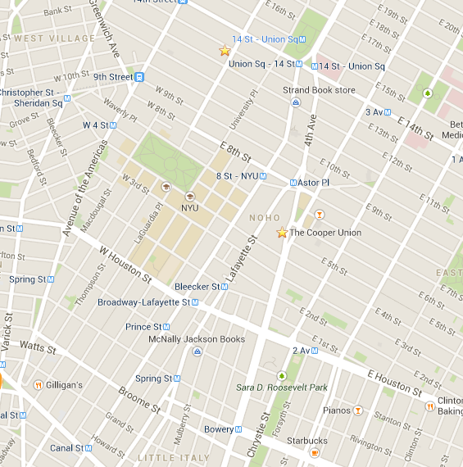
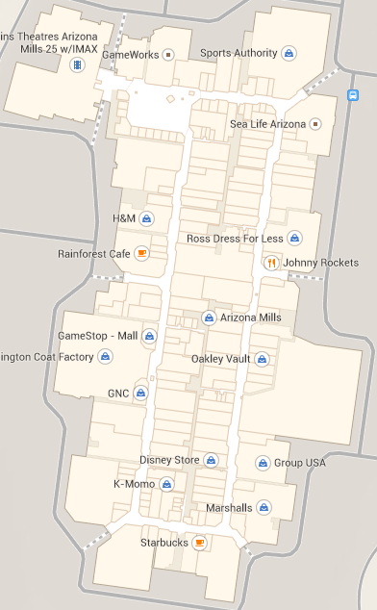
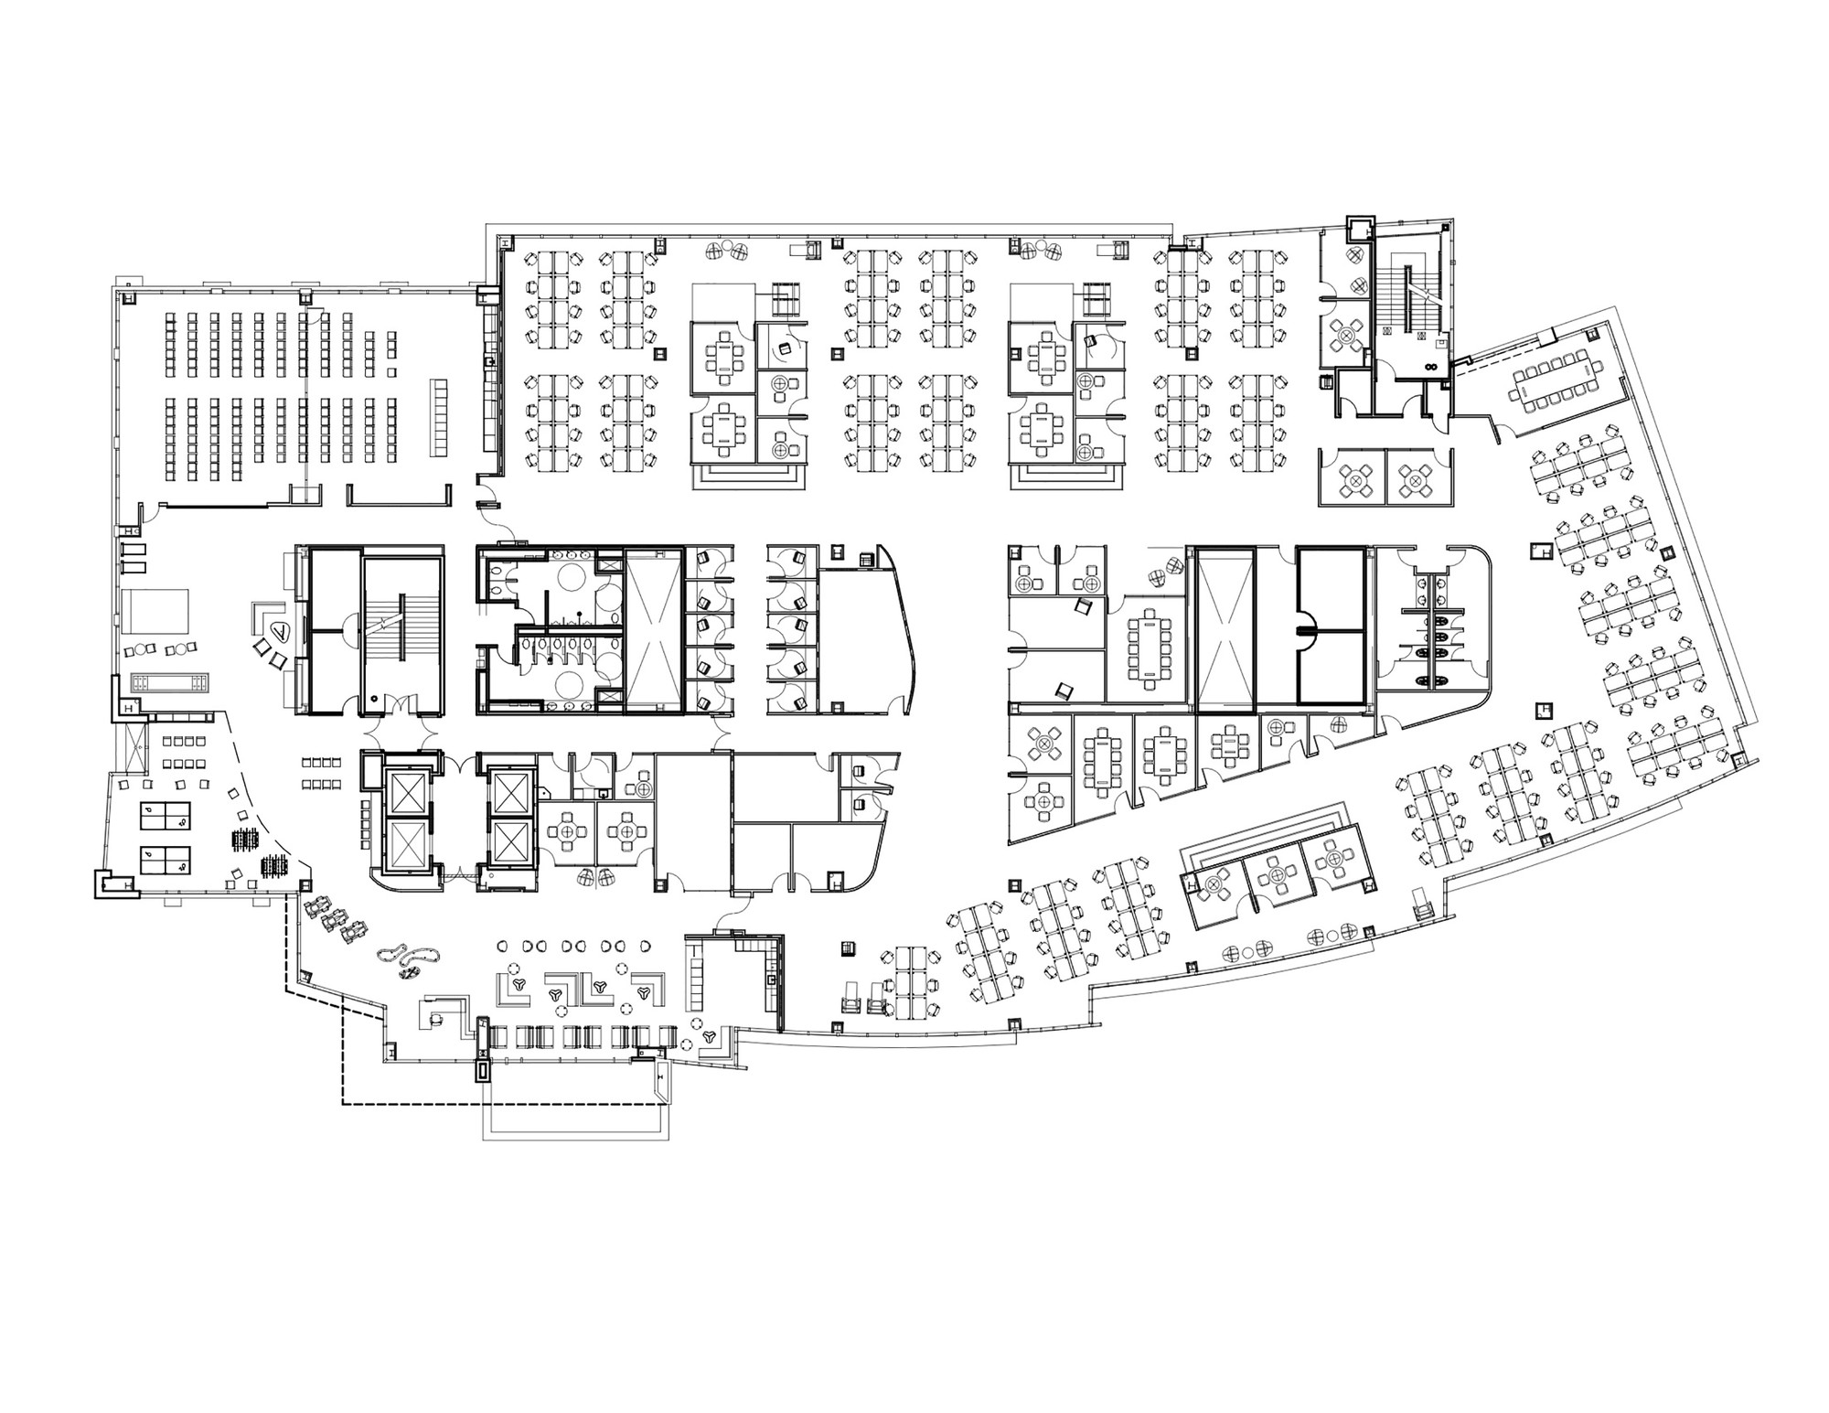
A discretized view
Real-world layout problems are often (semi-)quadrilateral.
Urban street layouts
Mall floor plans
Office floor plans
Notes:
The motivation of our IP-based approach is that, we can observe that many real-world layouts, such as street layouts and floor plans, are often locally aligned to four dominant directions. Therefore, to ensure the global consistency of such layouts, we propose to encode these four directions by a quad-dominant mesh

Slide 14
IP-based network design
IP
Smoothing
Subdivision
(Repeats)
Notes:
Therefore, we opt to pre-quadrangulate the problem domain and then take an integer programming based approach to solve the problem. After the input domain is quadrangulated, each edge now represents a potential segment of a street network, and finding the best network now becomes a discrete optimization problem of finding the subset of edges that best presents our interests. We solve the IP problem by Gurobi, which we are quite satisfied with. While this subset of edges may not look all that impressive for now…
[Click] a plausible looking network can be generated from it by applying a snake-based smoothing,
[Click]…and even better, we can subdivide the remaining space and repeat this IP/smoothing/subdivision process again, and in the end we can get a rich and plausible looking network design with hierarchical details.

Slide 15

IP problem statement
Find a subset of the edges in the mesh that optimizes
a (weighted) set of quality measures while
satisfying our validity constraints.
$$\underset{e_{i}∈E}{minimize}{ f(e_{i})} \\ subject to g\left(e_{i}\right)≤0, \\ h\left(e_{i}\right)=0, \\ and e_{i}∈\left\{0,1\right\}$$
Quality measures
e_{i} =0
e_{i}=1
Validity constraints
Notes:
Let’s specify the IP problem statement. The goal is to find a subset of the edges that best optimizes a weighted sum of quality measures while satisfying a set of our validity constraints. We encode the presence of each edge in the network as a Boolean variable ei. So, the problem becomes finding a subset of the Boolean variables that minimizes f(ei), a weighted sum of quality measures, while satisfying a set of validity constraints g(ei) and h(ei).

Slide 16
Valid network requirements
Coverage.
Connectivity.
“Sinks”
Uncovered
Valid networks
Invalid coverage
Invalid connectivity
Notes:
For a network to be valid, it needs to fulfill two requirements. First, it has to sufficiently cover the whole mesh, using the coverage range. Second, every part of the network has to be reachable from the set of predefined “sink” vertices we mentioned before. Otherwise the network would have isolated islands that no one can go to!
[Click] By our definitions, all these networks are valid and can be readily generated by our method. Here the red dots indicate the sinks. Note that the networks can have different topologies and even disconnected components, as long as each component is connected to a sink. [Click] However, This network is invalid because the upper-left part is not covered. [Click] And this is another invalid network because it has an isolated island on the bottom.

Slide 17
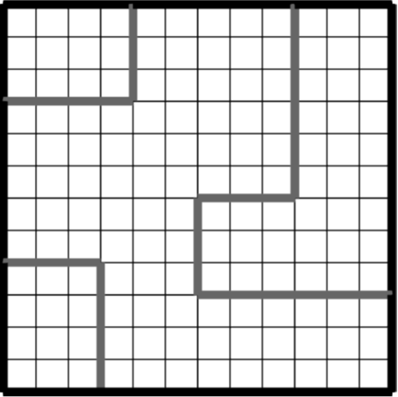

Modeling the coverage constraint
Every vertex is within the coverage range of the network edges.
$$\underset{v∈V}{∀}{\sum_{e_{i} covers v }{e_{i}≥1}}$$
(Coverage range = 2)
Notes:
Modeling the coverage constraint is easy. In short, we require that for every vertex, at least one of the network edges that cover it by the coverage range has to be present. This can be easily presented by some linear constraints…

Slide 18
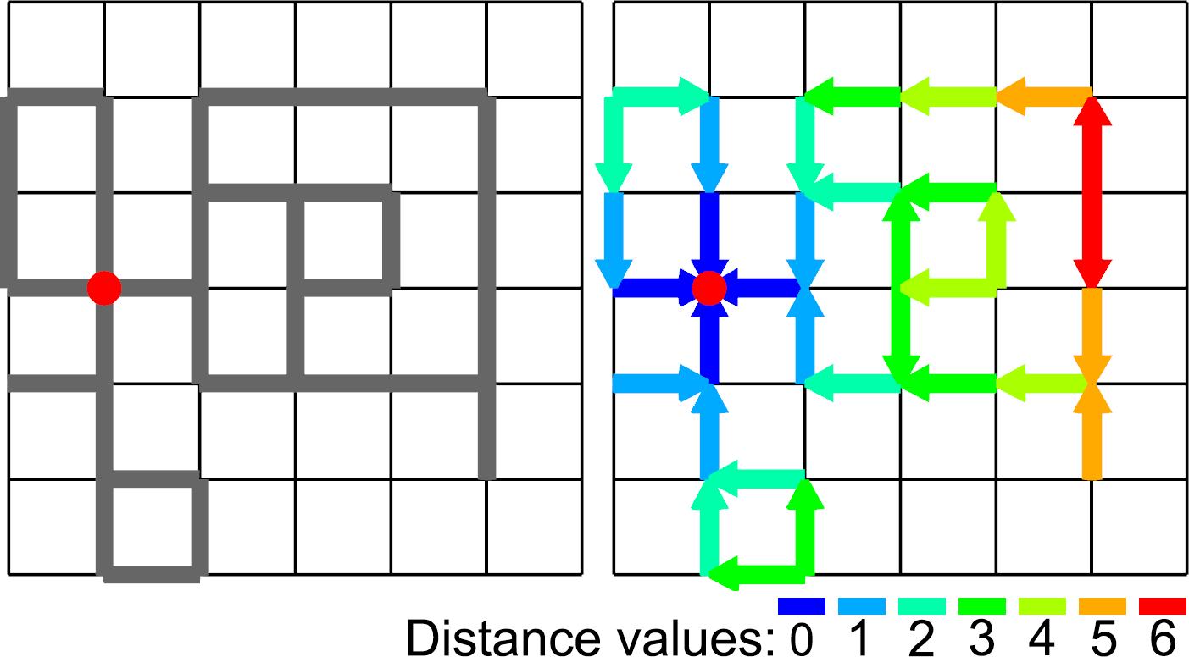
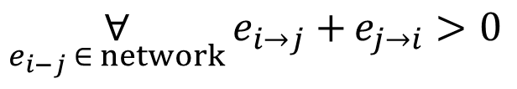
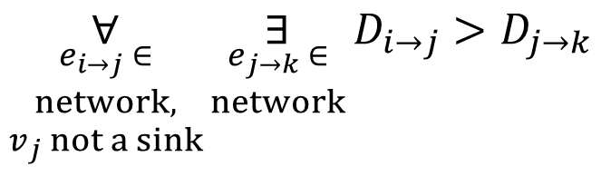
Modeling the connectivity constraint
Succeeding half-edges of a network must have descending “distance” values, except at sinks.
“Sinks”
$$\underset{e_{i−j} ∈ network}{∀}{e_{i→j}+}e_{j→i}>0$$
“Distance value”
$$\underset{\begin{aligned}e_{i→j} ∈ \\ network, \\ v_{j} not a sink\end{aligned}}{∀}{\underset{\begin{aligned}e_{j→k} ∈ \\ network\end{aligned}}{∃}{D_{i→j}>D_{j→k}}}$$
Notes:
However, modeling the connectivity constraint is not trivial because it is a global phenomena, and we spent quite some time to tackle this critical requirement. Inspired by an IP formulation of the traveling salesman problem, we model the connectivity constraint by requiring that the network is comprised of succeeding half-edges with descending distance values, except at sinks. One example is shown on the bottom, where the half-edges of the network directly at the sink are having a distance of 0, and the half-edges directly preceding them are having a distance value of 1, and so on. It is easy to see that such requirement would mean all half-edges are connected to the sinks, and the distance value associated with each half-edge would approximate the distance to the closest sink.
Note that by our formulation, loops are allowed. This is a generalization of the original traveling salesman problem IP formulation.
[Click] Again, they can be expressed as a combination of linear constraints. For details please refer to the paper.

Slide 19
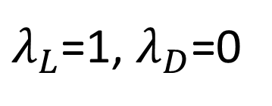
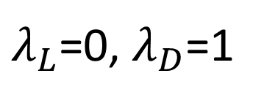
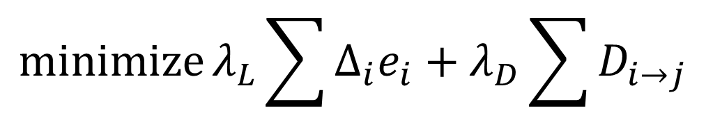
Energy function
Network length
Distances to sinks
$$\operatorname{minimize}{λ_{L}\sum{Δ_{i}e_{i}+λ_{D}\sum{D_{i→j}}}}$$
$λ_{L}$=1, $λ_{D}$=0
$λ_{L}$=0, $λ_{D}$=1
Len:60
Dist:279
Len:61
Dist:238
Len:67
Dist:151
Len:68
Dist:134
Len:69
Dist:128
Len:71
Dist:122
Notes:
The energy function that we want to minimize consists of a weighted sum of two terms. [Click] The first is the total network length, which can be conveniently expressed as the sum of present edge variables multiplied by their Euclidean lengths. [Click] The second is the sum of distances to the sinks, which can also be conveniently expressed as the sum of the aforementioned distance values. [Click] Below we show a spectrum of results using different weightings. We can see the networks become shallower, use more edges, and have more exits to the boundary as the weighting to the distance to sinks increases.

Slide 20
Enhance interior-to-interior traffic
“Point-to-point constraint” to boost interior connectivity.
“Sinks”
Sample points
“Sinks”
Notes:
Note that the distance to sinks term mentioned earlier can only enhance interior-to-boundary traffic.
To enhance interior-to-interior traffic, we take a simple approach, called “point-to-point constraint”, that can effectively boost the interior connectivity of the network. In short, we randomly sample the problem domain in a spatially uniform manner and then require that nearby sample points must be connected by a semi-shortest path. Examples are shown below.
This is a cheap and effective constraint to enhance interior-to-interior traffic, and the strength can be easily controlled by the sampling density. On the down side, this constraint can over-constain the resulting networks.

Slide 21
Functional specifications
Density
Sinks locations
“Short-cuts”
Traffic types
Local features
Network lengths vs. travel distances
User specifications
Notes:
We summarize how the functional specifications are supported by our IP formulation.
[Click] Density is specified by the coverage range, or, the resolution of the quadrangulation in the first place.
[Click] Interior-to-boundary traffic is naturally supported as long as we put sinks on the boundary. Interior-to-interior traffic is supported by the interior connectivity constraint mentioned earlier. Boundary-to-boundary traffic is supported by user specified short-cuts.
[Click] The preference between minimizing network lengths and travel distances is specified by the weighing of the two terms of the objective function.
[Click] Sink locations are an intrinsic part of our IP design, and our connectivity constraint would ensure that all traffic do CAN reach the sinks instead of trapped somewhere inside an island.
[Click] Finally, the local features and the user specifications all can be trivially specified as linear constraints.

Slide 22
Applications and Results
Notes:
Let’ see some results.

Slide 23
Street networks for different functional goals
Min. network length vs. travel distance
Tree-like topology
Encourage vertical through-traffic
Higher connectivity
Notes:
Here we show some street network results that cater to different functional specifications that well summarize the types of networks our method can produce.
The first pairs contrast minimizing network lengths versus minimizing travel distances. Note that this specification is also applied to the sub-level networks.
A layout with a tree-like topology, realized by restricting a single exit to the boundary.
A layout that encourages through-traffic in the vertical direction by providing a short cut from top to bottom.
And, a layout that is more tightly connected enabled by the point-to-point constraint, which makes interior-to-interior traffic easier.

Slide 24

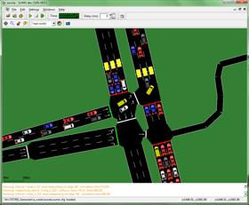
Design study
?
King’s Cross re-development
SUMO: Simulation of Urban MObility
Notes:
We also conducted a design study with a collaborating urban designer. The goal was to propose street layout designs for a redevelopment near the Kings Cross station in London, famous for Harry Potter. The colored arrow pairs indicate external traffic demands. We also deployed SUMO, a state-of-the-art and widely used traffic simulation tool, to quantitatively evaluate the traffic behaviors of the resulting networks.

Slide 25
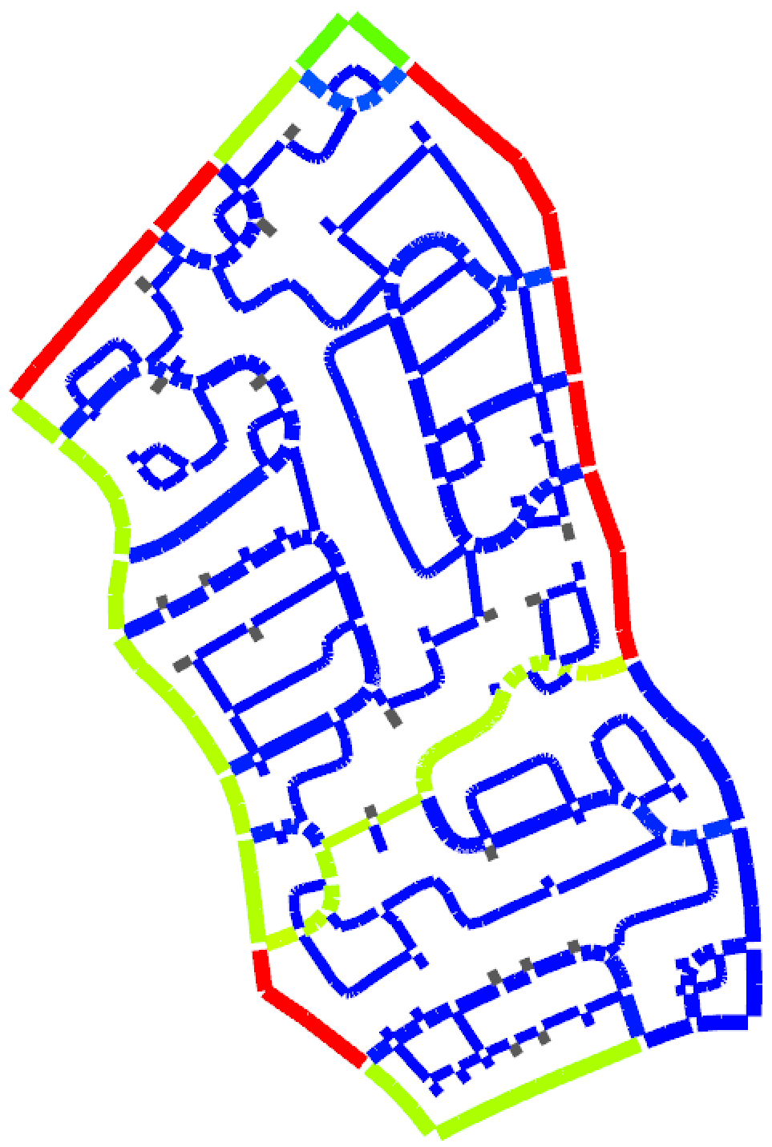
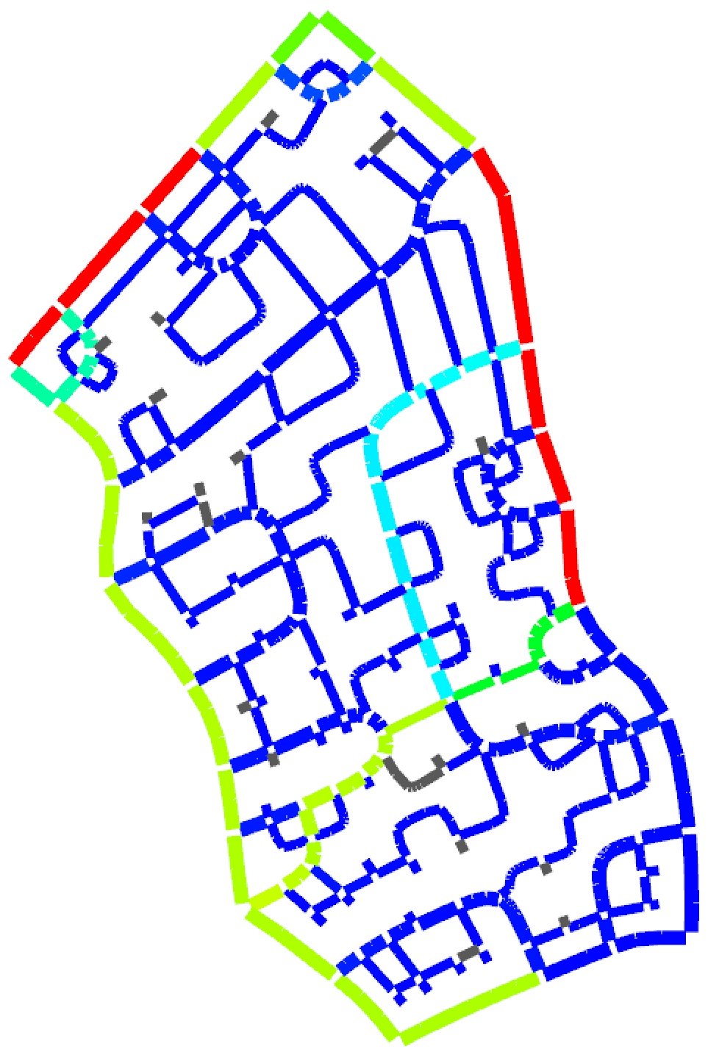
Design study
Length: 18063
SUMO time: 20s
Length: 19417
SUMO time: 18s
?
Traffic
0
1000
King’s Cross re-development
SUMO
Notes:
The first pair of results contrast a network optimized for minimal network lengths (on the left) and a network optimized for travel distances to the boundary (on the right). Statistics from SUMO traffic simulation confirms our assumptions, saying that the latter indeed have less average travel times to the boundary. We also color-code the amount of traffics on each street taken by both interior and external traffic demands according to SUMO. For these two results, they look similar and both reasonable.

Slide 26
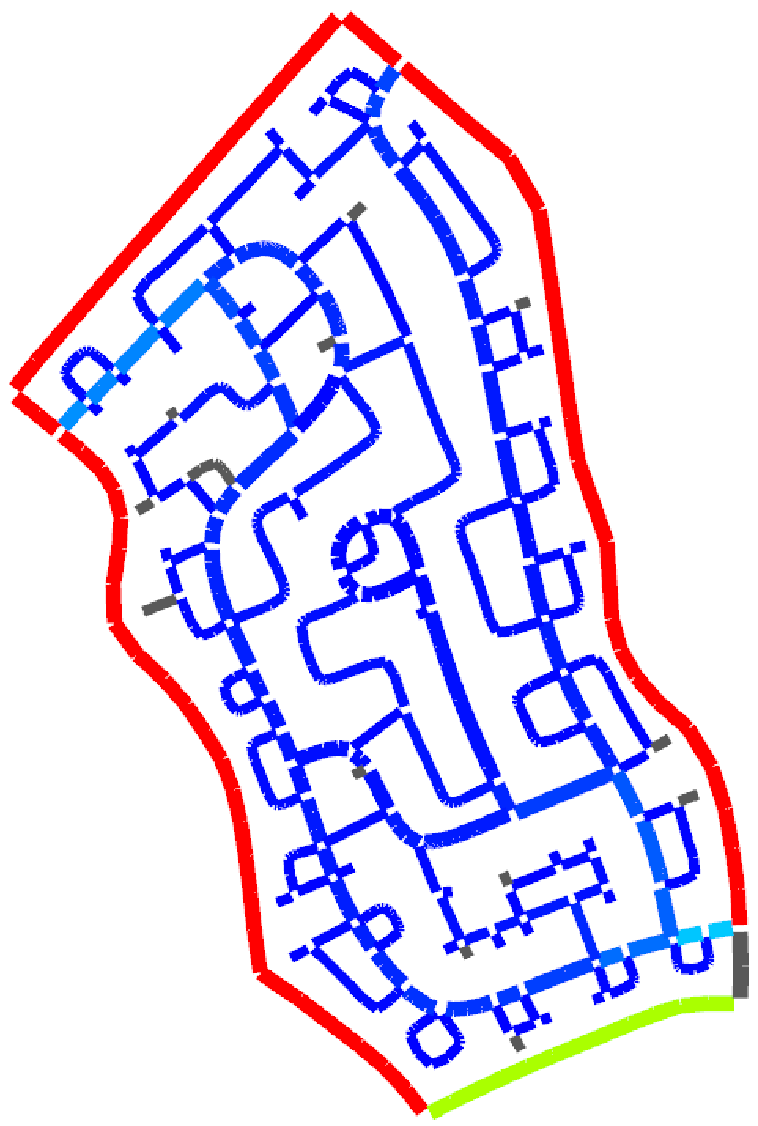
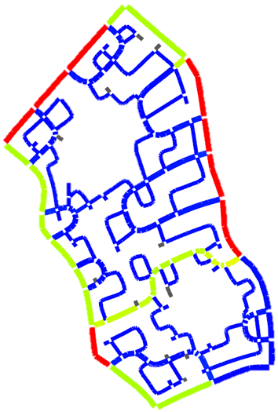
Design study
Length: 18063
SUMO time: 20s
Length: 19417
SUMO time: 18s
?
Traffic
0
1000
Length: 18115
SUMO time: 50s
Length: 16373
SUMO time: 19s
King’s Cross re-development
SUMO
Notes:
For the third one, we simulate a situation where the numbers of exits to the boundary is rationed, something common for a suburban subdivision development. The result is a network with moderate network lengths, but quite long travel times compared to the first two. Also, it is interesting to note that the external traffic practically avoids all the interior while only taking the boundary routes, resulting in a quiet neighborhood.
[Click] Finally, we simulate a case with some parks and lakes inside the domain. To ensure the street network would avoid those areas, we mark them as obstacles.

Slide 27
Conclusions
Contribution:
  An IP formulation for synthesizing street networks purely from functional specifications.
Limitations:
  Computation time and scalability.
  Linearity of the IP formulation.
  Infeasibility due to conflicting constraints.
Notes:
In conclusion, the main contribution of our work is to provide an explicit IP optimization formulation for synthesizing street networks purely from functional specifications. Via design studies, we showed that our results are of practical values and may be time-saving for urban designers.
The main limitation is that the computation time is still far from being interactive, and cannot be scaled up easily unless we do some partitions of the problem domain first. Another practical limitation is that the IP formulation has to be in linear form, and any new additions and modifications have to be also in linear form, otherwise the problem can become too expensive to solve.
Also, the IP problem may become infeasible due to conflicting constraints, this is quite annoying and currently it takes trial-and-error to find out what caused the problem to become infeasible. We hope to propose solutions to address this shortcomings in future work.

Slide 28
Acknowledgements
Input from the urban design community:
Daniel Fink (co-author), Steven Marshall, Benjamin Heydecker, Carlos Molinero, Clementine Cottineau, and Elsa Arcaute.
Funding sources: ERC Starting Grant SmartGeometry, Marie Curie CIG, National Science Foundation, Office of Sponsored Research (OSR), KAUST, EPSRC Grants, and National Natural Science Foundation of China.
Notes:
We would like to thank various people from the urban design community for their valuable insights and our funding sources.

Slide 29







www.nogle.com
Notes:
I would also like to thank my current company for sponsoring my travel. In short, Nogle congregates software talents from the fields of computer graphics, finance, mobile platforms, and data science. To know more about our company, please come to me after the talk.

Slide 30
Thank you!
Functional specifications
Notes:
Thank you for listening, and I am happy to take questions.

Slide 31
Backup slides

Slide 32
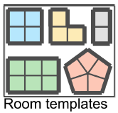
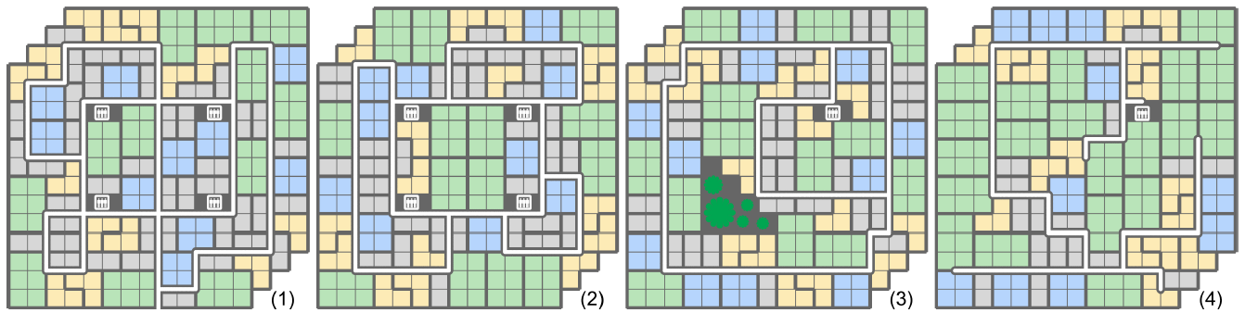
Work in progress: floorplans
Solving both the corridor networks and the
room placements (tiling problem) in one IP optimization.
Notes:
Finally, we also tried our approach on generating floorplans and the companying corridor networks for larger buildings. The main advantage is that we can solve the corridor networks and the room placements, which are essentially a tiling problem, in one IP optimization pass. So we don’t need to iterate between the two. The downside is that the optimization becomes quite more expensive to solve.

Slide 33
TODO: game layout slide.

Slide 34
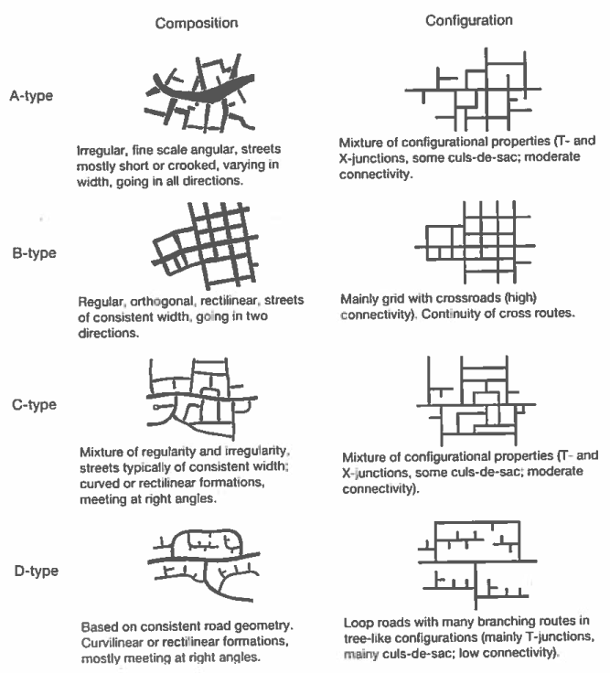
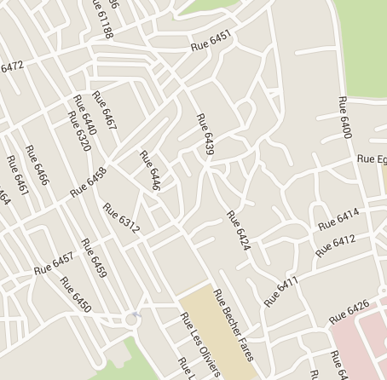
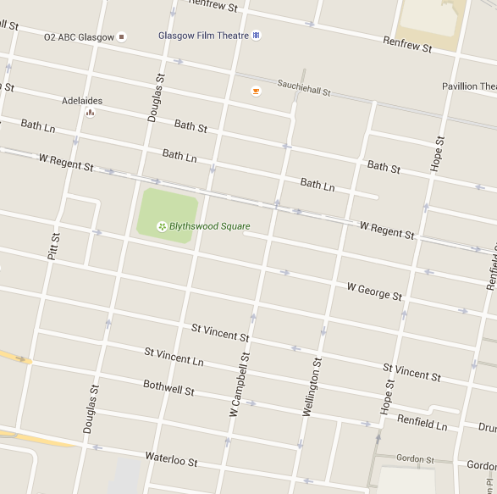
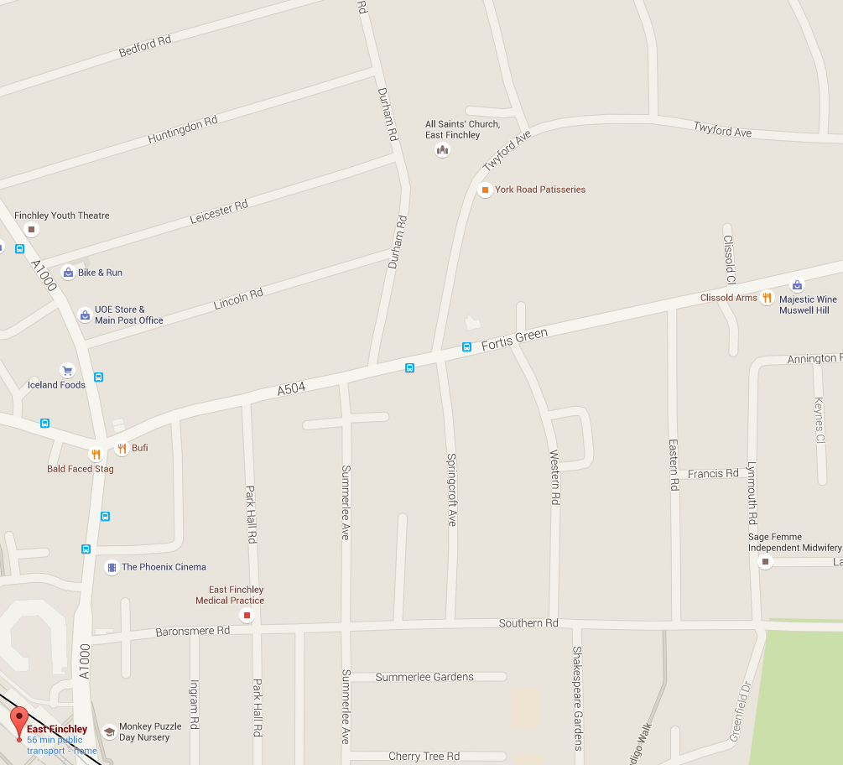
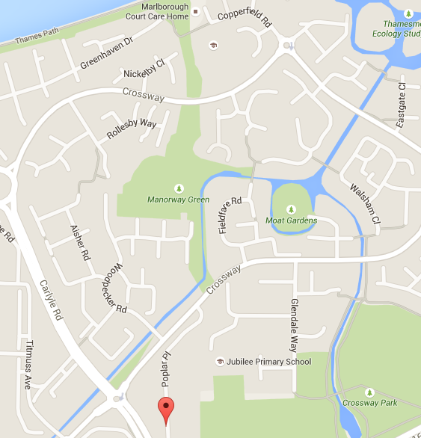

A-type: Tunis
B-type: Glasgow
C-type: East Finchley
D-type: Thamesmead
Streets & Patterns, Steven Marshall
Notes:
One interesting phenomena practitioners observed is that real-world street layouts seem to be dominated by only a couple of major types of street patterns. One such categorization is shown in the book Streets and Patterns by Steven Marshall. [He showed that there seem to exist four major kinds of street patterns, one for historical downtowns, maybe European ones, one for Manhattan-like grids, one for a mixed street pattern such as East Finchley of London, and finally a tree-like configuration, with lots of dead-ends or Cul-de-Sacs, favoured by modern car-centric suburban neighbourhoods.]
Our idea is that they merged mainly to serve different functional goals in terms of traffic flows, land use, and topology constraints. We define such purposes as “functional goals” or “functional specifications”. This observation motivates our research.
Peter: I do not really agree with the last part. To me the question is now to know how well do the street patterns actually perform when confronted with different traffic models / traffic demand. Basically, how well do the patterns perform to transport goods and people.
But even that seems tangential to the paper. I consider the main point to be rather what I wrote about transport modeling / supply and demand / … in the paper.
The question is that if you are given a demand for transporting goods and people, what network is best suited. This didn’t fully happen in the paper, but that was still the main idea behind this work. At least my main idea behind this work.
I somehow think the slide is not informative and it could also be deleted altogether.

Slide 35
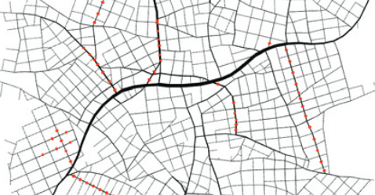
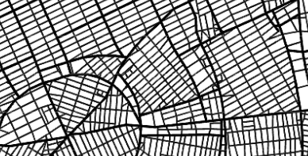
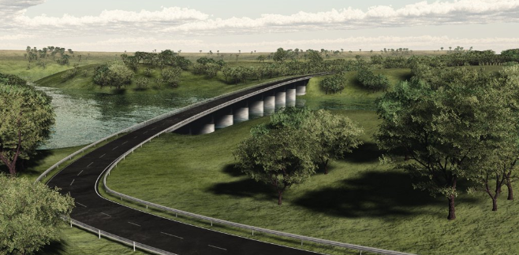





Related work - street modeling
[Parish and Muller 2001]
[Vanegas et al. 2012]
[Marechal et al. 2010]
[Weber et al. 2009]
[Yang et al. 2013]
[Peng et al. 2014]
[Vanegas et al. 2009]
[Chen et al. 2008]
[Aliaga et al. 2008]
[AlHalawani et al. 2014]
[Garcia-Dorado et al. 2014]
Street synthesis
Street optimization
Traffic consideration
Notes:
Before show you the details of our work. I would like to discuss a bit of the related work.
[click] Early street modeling work focused on how to synthesize street networks that resemble exiting ones. Different methods have been proposed, including procedural modeling based on L-systems [click], enhanced with vector fields [click], and example-based approaches [click].
In the recent years, several works were proposed to optimize street networks with different considerations, such as [click] building sunlight exposure, [click] interaction between road and environment, [click] the quality of parcel shapes, and [click] street network descriptors.
There were several works with traffic considerations. For example, [click] Weber and co-authors consider traffic during street network expansions. [click] Vanegas and co-authors optimized street width under guidance of a traffic demand model. Recently, Garcia and co-authors studied how to design traffic behavior in a urban environment based on modifying an existing street network with random updates.
Our work focus on directly generating the topology and geometric layout only from functional specifications

Slide 36

Related work - layout modeling
[Yu et al. 2011]
[Merrell et al. 2011]
[Merrell et al. 2010]
[Liu et al. 2013]
furniture layout
floorplan layout
[Bao et al. 2013]
[Genevaux et al. 2013]
[Ma et al. 2014]
building layout
river network
game level layout
Notes:
Our work is also related to other layout modeling work in different design contexts, such as [click] furniture layout, [click] floor plan layout, [click] building layout, [click] river network, and [click] game level layout.

Slide 37
Network design from functional specifications
Design
Involve function considerations into the design stage!
Functional Design
Function
Test
Notes:
To simplify the network design process, we propose to design networks with functional specifications, [click] to achieve a so-called functional design.
[click] The basic idea is to involve function considerations into the design stage, to make function test more like a sanity check.

Slide 38
Current design practice - keywords
complex
interdisciplinary
intuition
experience
rules-of-thumb
analytic modeling & simulation
urban designers & planners
transport planners
traffic engineers
landscape architects
gradual testing and refining with many iterations
network design
functional requirements
Notes:
Here are several keywords of the current design practice.
[click]
First of all, the design process is very complex. [click] It relies on a wide range of inputs, including intuition, experience, rules-of-thumb, analytic modeling and simulation.
[click]Also, the design process is interdisciplinary. [click]It involves urban designers and planners, landscape architects, transport planners and traffic engineers, each with particular sets of knowledge to apply and optimal conditions to design.
[click]To make an initial network design meet practical functional requirements, a real design practice usually requires gradual testing and refine process with many iterations.
[click]Overall it is a long way to go from initial network to the final design satisfying function requirements.

Slide 39
Our solution
Quantitatively measure functional specifications on networks
  density
  total length
  …
Mathematically formulate functional design as integer programming (IP)
  balance conflicting specifications
  enforce functional constraints
Applications
  urban planning
  floorplan generation
Notes:
Overall, our solution is to quantitatively measure functional specifications on networks, [click] such as density, total length, etc.
And mathematically formulate functional design as integer programming, [click] to balance conflicting requirements and [click] enforce functional constraints.
[click]And the IP-based network design tool can be used in applications like urban planning and floorplan generation

Slide 40
Valid network requirements
Coverage.
Connectivity.
“Sinks”
Notes:
For a network to be valid it needs to fulfill two requirements. First, it has to sufficiently cover the whole mesh. Second, every part of the network has to be reachable from the set of predefined “sink” vertices we mentioned before.
[Click] Below we show some examples of valid networks that our IP optimization can generate. Note that the network can have various kinds of topologies, and even have disconnected components, as long as each component is connected to a sink.

Slide 41



Modeling connectivity constraint
A global phenomenon – cannot be modelled locally.
$$\underset{\begin{aligned}v ∈ \\ network\end{aligned}}{∀}{\sum_{e_{i} touches v }{e_{i}≥2}}$$
By coverage
constraint alone
Forbid dead-end vertices
Notes:
However, modeling the connectivity constraint is not so trivial. [click] If we only enforce the coverage constraint, the result is likely a scatter of isolated edges, something like a minimal edge cover. The selected edges are shown thicker than the non-selected edges. [Click] If we try to solve it by imposing local constraints, like forbidding dead-end vertices, the result is likely a collection of disconnected loops.

Slide 42
Optional quality measures
Enhance interior-to-interior traffic.
Local feature control.
Dead-end
T-junction
Zig-zag
…
Notes:
We also provide two optional quality measures.
[Click] First is a measure to enhance interior-to-interior traffic by enforcing a higher degree of internal connectivity of the network.
[Click] Second are measures to control the local features of the network. In short, we can control the numbers of their presences either as hard constraints or as terms of the energy function in a soft sense.

Slide 43

Point-to-point constraints
Notes:
Note that the distance to sinks terms can only enhance interior-to-boundary traffic. To enhance interior-to-interior traffic, we take a simple sample-based approach. In short, we pre-segment the problem domain into a set of sub-domains and sample one vertex per sub-domain. Then, we require that for every pair of adjacent sub-domains, the network much connect their sampled vertices by a semi-shortest path. This is a cheap and effective constraint to enhance interior-to-interior traffic, and the degree can be easily controlled by the partition density. On the down side, this constraint can over-constaint the resulting networks.
Peter: maybe we should delete this from the talk, since it’s just a simple hack.
I would just list a set of extensions (we should have a few more) in one page instead.

Slide 44
Why an integer programming approach:
Solved by very powerful IP solver, which have state-of-the-art performances
And is getting better everyday.
Potential to find non-trivial solutions that are hard to be retrieved by local
Methods.

