Slide 1
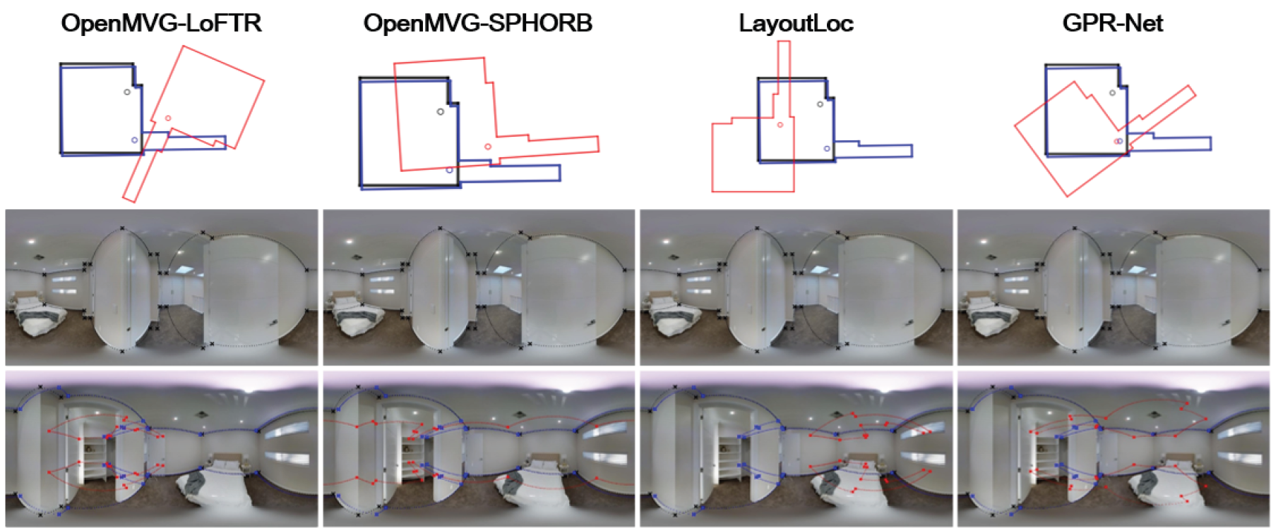
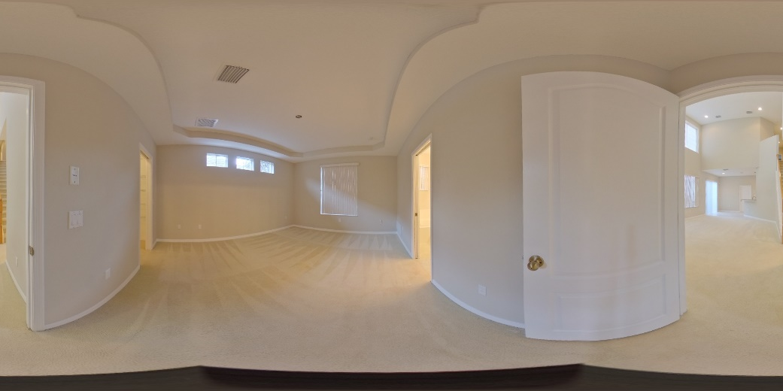
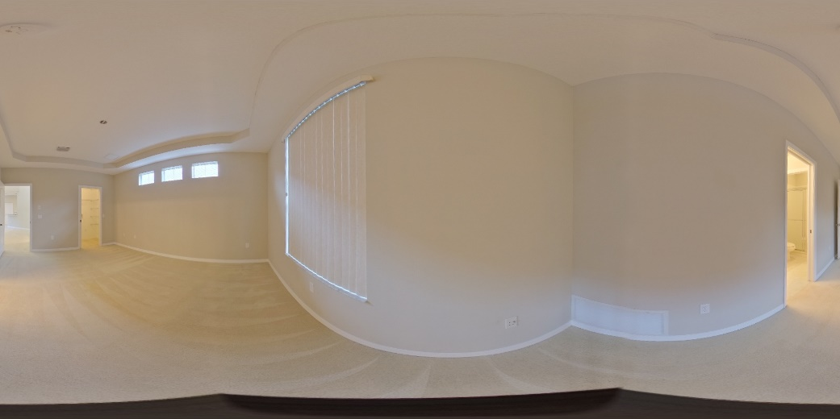
Interactive Relative Pose Estimation for 360◦ Indoor Panoramas through Wall-Wall Matching Selections
Bo-Sheng Chen¹, Chi-Han Peng¹
¹National Yang Ming Chiao Tung University (NYCU), Taiwan
Problem
Estimating the relative camera poses between two sparse 360° panoramas is very difficult for both traditional 8-point methods and neural networks. However, manual baseline is slow and error prone.
Difficult even for humans!
Challenging cases:
Large camera poses and featureless regions.
Manual baseline needs precise manual selection of >=8 feature point pairs.
Failure cases of SOTA traditional and neural methods.
Method
Leveraging modern room layout prediction methods to get the wall candidates of two panoramas, we reduced the manual task to simply selecting one pair of matched walls.
Just requires two mouse clicks or two keyboard strokes (e.g., wall numbers).
No need for precise selection of points on screen anymore.
(a) use an existing method to estimate a room layout for each of the panoramas. (b) The user selects a pair of matching walls. (c) Two sets of matched feature point pairs are generated based on the wall-wall pair using our novel approach. (d) A camera pose is calculated using the generated feature point pairs.
Experiment Results
Evaluated on Zillow Indoor Dataset and Matterport3D dataset, our method significantly outperformed traditional 8-point methods and outperformed SOTA neural methods (CoVisPose and GPR-Net) on the unseen Matterport3D dataset.
This work is funded by the National Science and Technology Council of Taiwan (project number 111R10286C).

